Slide 1
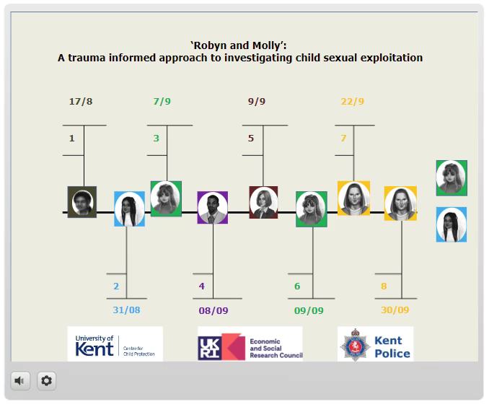
Walk-Through Demonstration of ‘Robyn and Molly:’ A Trauma Informed Approach to Investigating Child Sexual Exploitation

