Slide 1
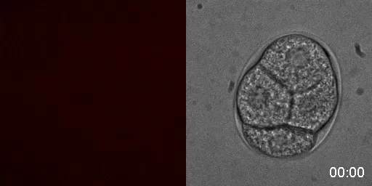
Film 4.
mCherry-ACT-1 in C. elegans
Time lapse film of mCherry-ACT-1 in C. elegans embryo development from 4 cells to just prior to hatching. 999 Images were taken at 1 per minute.
Time in hours and minutes.
Images obtained using this lab’s Spinning disk confocal microscope

